Slide 1
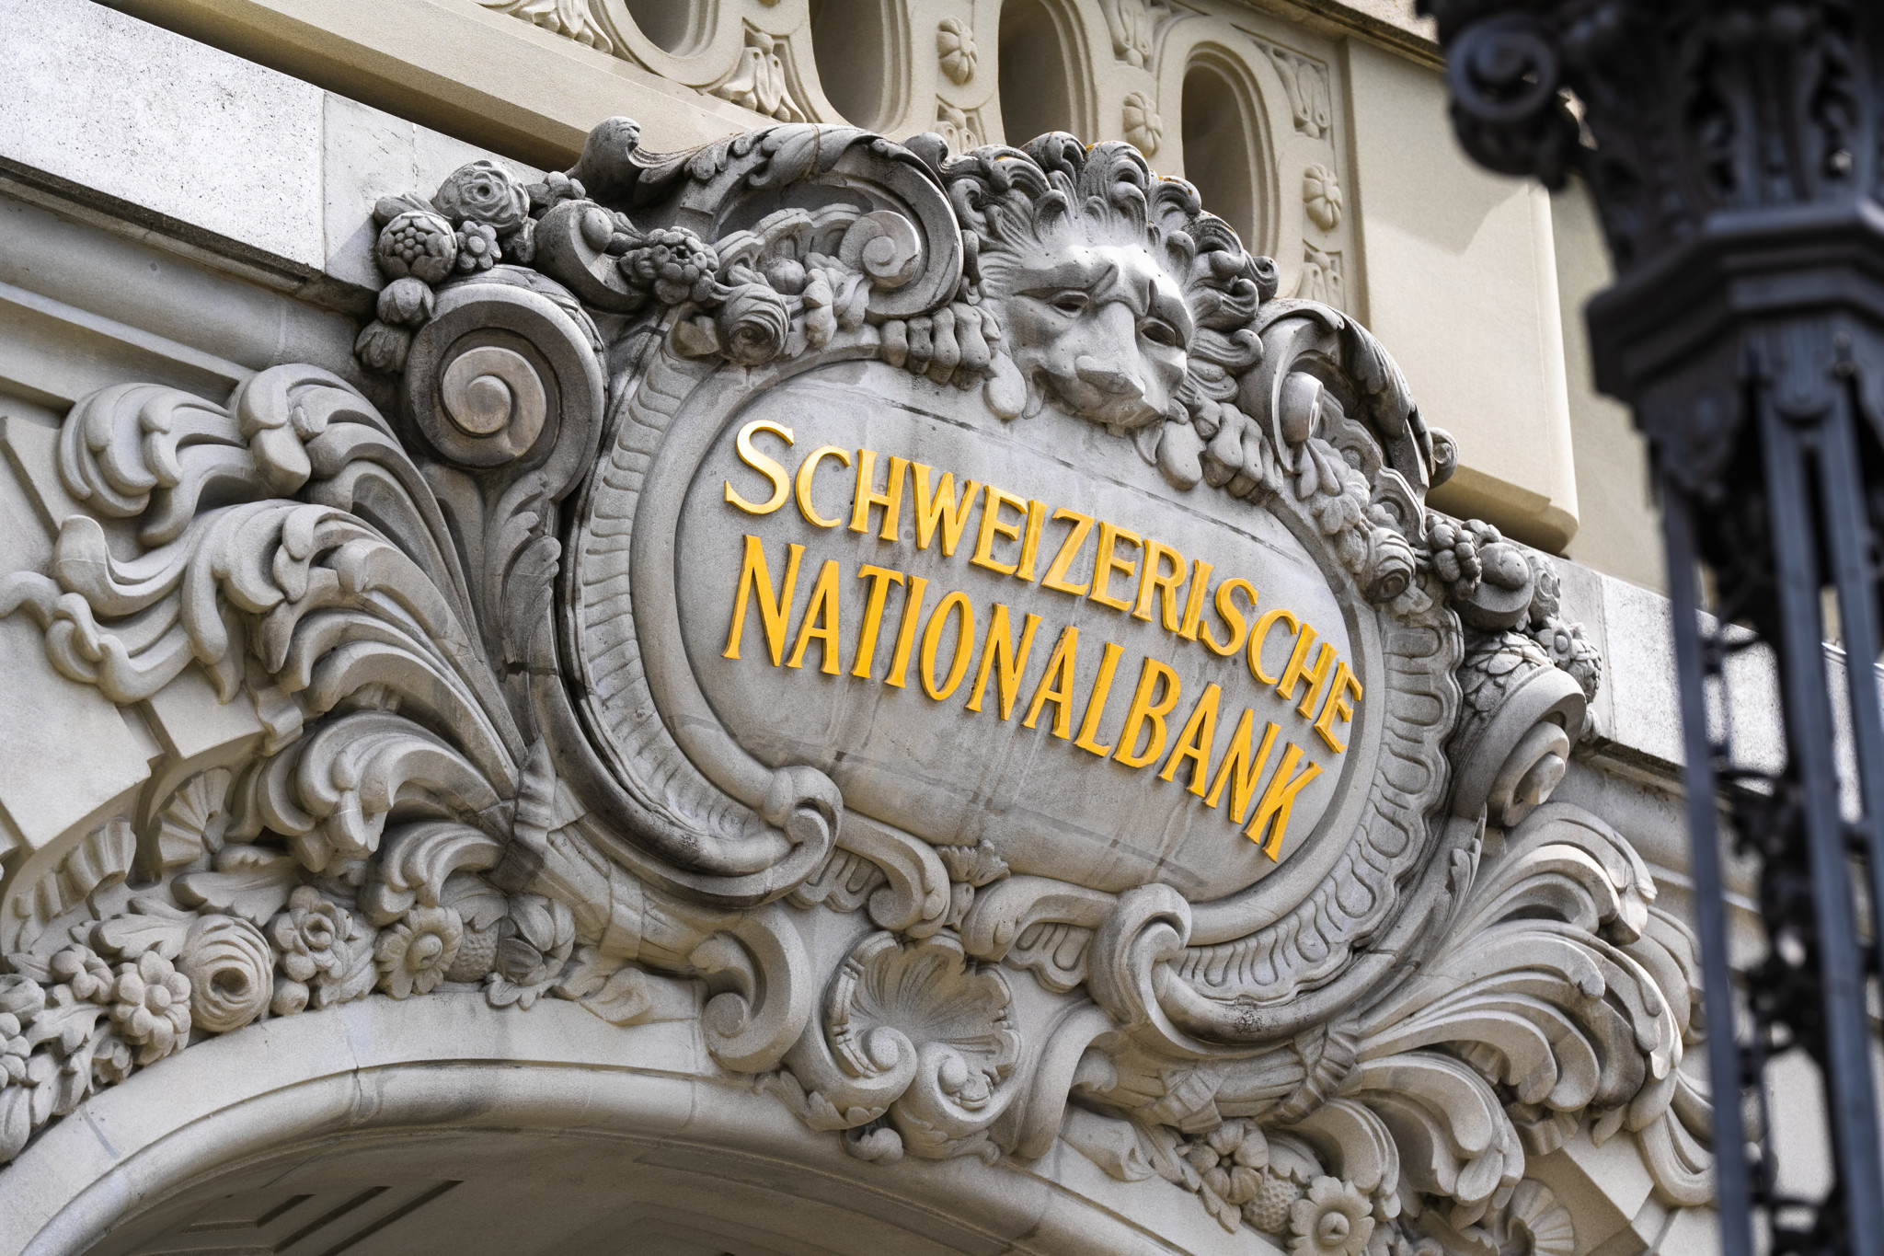

SNB’s FX interventions
SNB’s FX Interventions
Zurich, 29th of November 2025
Angus Martin
Johannes Ahlmann

Slide 2

Agenda
1
Literature overview
1.1
Why Central Banks Intervene in FX Markets
3
1.2
Effects of FX Intervention on Central Bank’s BS
4
1.3
The SNB and the “Safe Haven” Challenge
5
2
Empirical analysis
2.1
Asset-Side Approach 1.0 – Model & Results
7
2.2
Liability-Side Approach – Model & Results
9
2.3
Asset-Side Approach 2.0 – Model & Results
11
2.4
Comparisons
13
1
SNB’s FX interventions

Slide 3
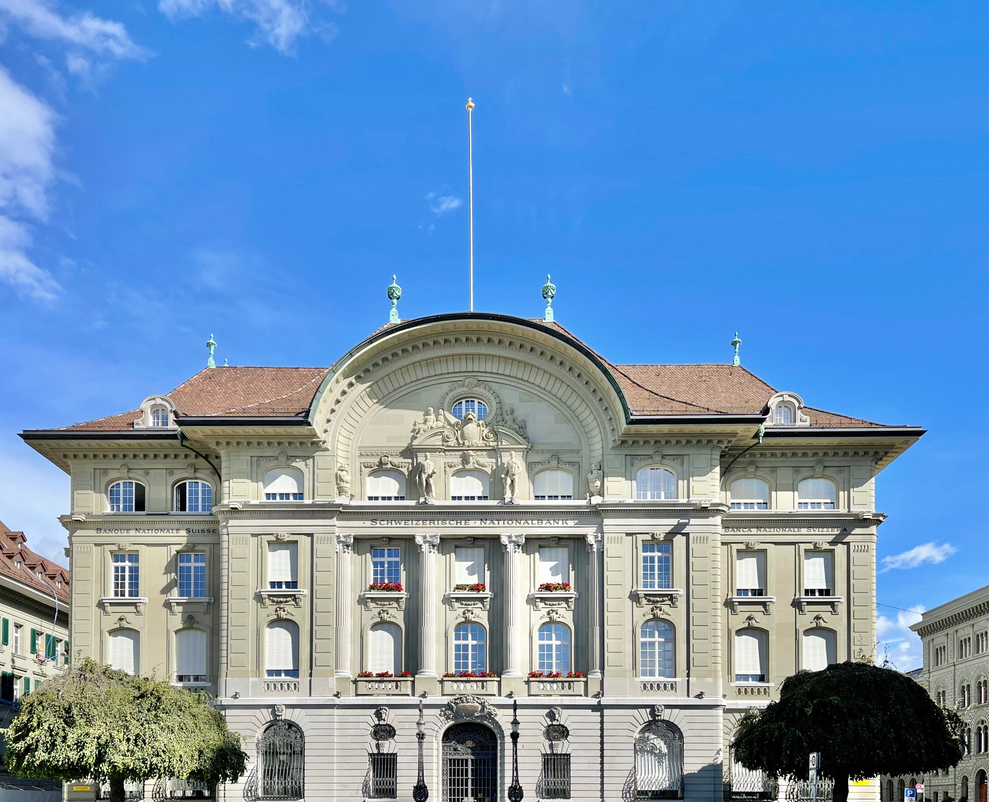
SNB’s FX Interventions
1 Literature overview
1

Slide 4







1.1 Why Central Banks Intervene in FX Markets
Intermediate Objectives
Goals
1
Influence the level of exchange rate
2
Smooth the trend path of the exchange rate
Price stability
Building reserves
3
Limit pressure caused by international investors
External competitiveness
Smooth commodity prices
Manage capital flows
4
Limit exchange rate volatility
Contain stressed trading conditions
FX funding shortages
5
Provide liquidity to thin market
3
Source(s): BIS
SNB’s FX interventions

Slide 5
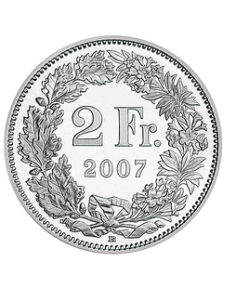
1.2 Effects of FX Intervention on Central Bank’s BS
Pre-Intervention BS of a Central Bank
Post-Intervention BS of a Central bank
Assets | Liabilities
FX Reserves | Notes
 | Required Reserves
 | Free Reserves
 | Government
Other
 | Capital and Provisions
Assets | Liabilities
FX Reserves | Notes
 | Required Reserves
 | Free Reserves
 | Government
Other
 | Capital and Provisions
Assets | Liabilities
FX Reserves | Notes
 | Required Reserves
 | Free Reserves
 | Government
Other
 | Capital and Provisions
4
Source(s): Bank of England
SNB’s FX interventions

Slide 6
1.3 The SNB and the “Safe Haven” Challenge
September 2011
Introduction of minimum CHF/EUR exchange rate
March 2009
SNB begins intervening in FX market
January 2015
SNB abandons the CHF/EUR floor
2015-2020
Active FX purchases in periods of low inflation
Q4 2022
Change in monetary policy and shift toward selling foreign currency
Financial Crisis
Euro Crisis
Exit and Market Shock
Negative Policy Rate
Covid Period
2011-2014
Swiss economy stabilizes
Since Q1 2024
Neutral position
2007-2011
Strong appreciation pressure on Swiss franc
2014
ECB introduces further extensive monetary policy easing measures
2015
Swiss franc shock challenges export-oriented companies
2021
Increasing inflation and discontinuation of buying foreign currency
June 2010
SNB stops FX interventions
5
Source(s): SNB, Journal of International Money and Finance
SNB’s FX interventions

Slide 7
SNB’s FX Interventions
2 Empirical analysis
1

Slide 8
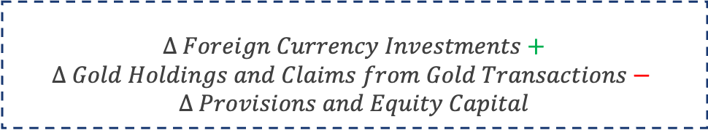
2.1 Asset-Side Approach 1.0 – Model
Model
Description
We use the following calculation with the MoM change for each of these balance sheet line items
Provisions and Equity Capital absorb valuation changes
Limitations
Equity Capital and Provisions changes do not account for Dividend and Interest Payments from the Equity and Bond holdings
Therefore tends to overestimate the FX intervention
Calculation
$$∆ Foreign Currency Investments+$$
$$∆ Gold Holdings and Claims from Gold Transactions−$$
$$∆ Provisions and Equity Capital$$
7
Source(s): SNB
SNB’s FX interventions

Slide 9
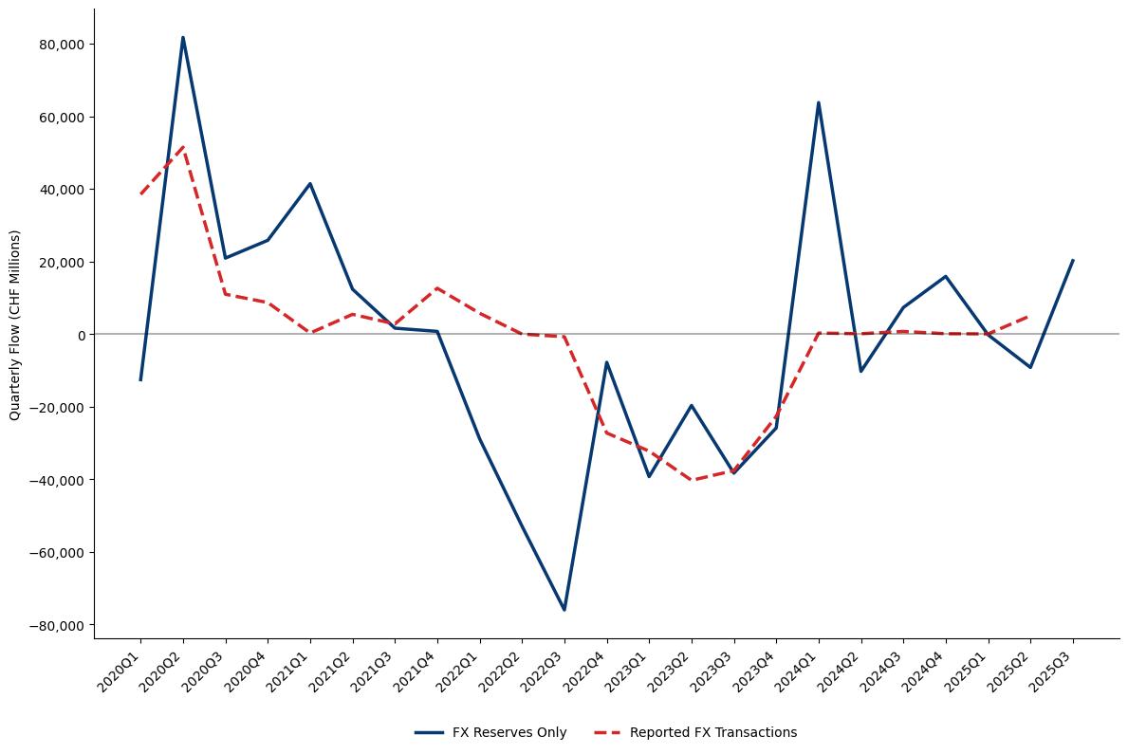
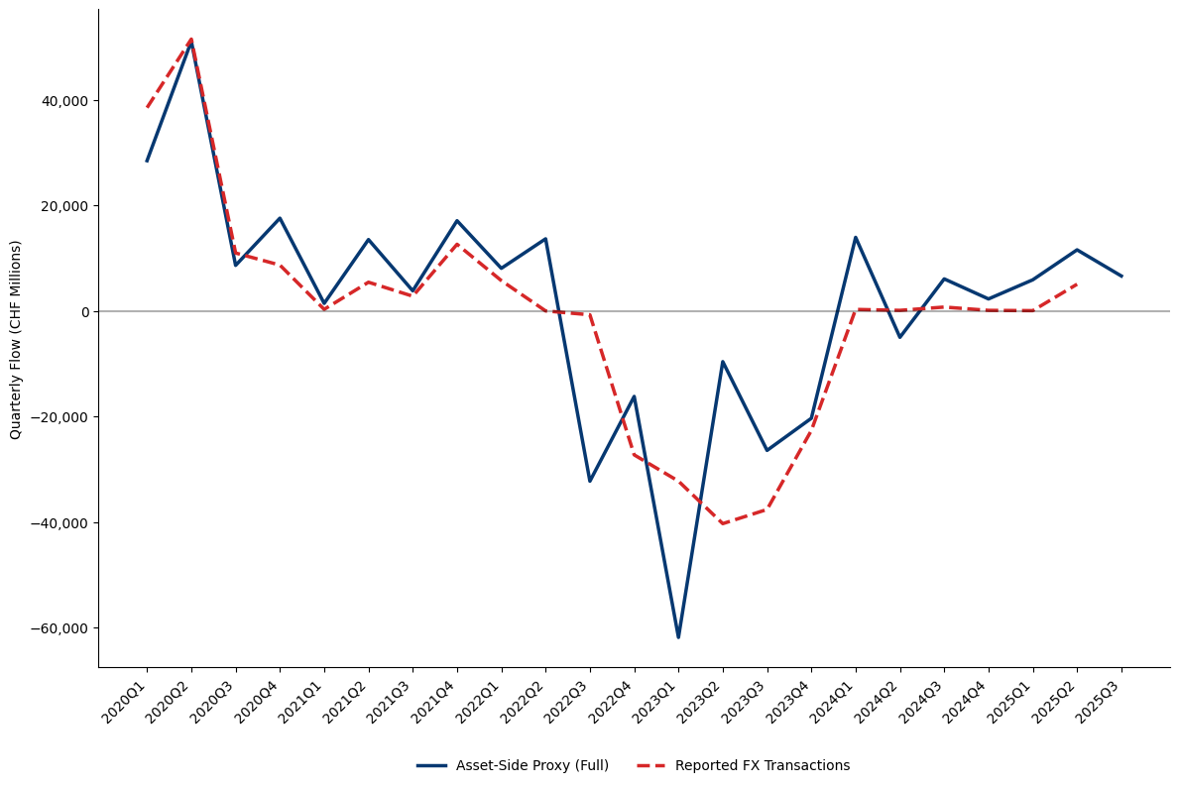
2.1 Asset-Side Approach 1.0 – Results
FX Reserves Only vs Reported FX Transactions
Full Asset-Side Proxy vs Reported FX Transactions
1-Month Delay
1-Month Delay
8
Source(s): SNB
SNB’s FX interventions

Slide 10
2.2 Liability-Side Approach – Model
Model
Description
When Foreign Currency Investment increases, Sight Deposits naturally increase, so these act as our main proxy
Subtract all liquidity injections unrelated to interventions, and add back all liquidity drains that could mask interventions
We also add back Foreign Currency Liabilities as this helps account for periods of emergency lending
Limitations
We have access to weekly sight deposit changes, however we don’t have weekly data for the other adjustments, so the predicition is too noisy
Liquidity Injections
Liquidity Drains
Bank Notes in Circulation
Secured Loans
Claims from CHF Repo Transactions
Liabilities from CHF Repo Transactions
SNB Debt Certificates
Foreign Sight Deposits
Calculation
$$∆Domestic Sight Deposits+ ∆Foreign Sight Deposits+∆SNB Debt Certificates+ ∆Liabilities from CHF Repo Transactions+∆Foreign Currency Liabilities −∆Bank Notes in Circulation−∆Secured Loans−∆Claims from CHF Repo Transactions$$
9
Source(s): SNB
SNB’s FX interventions

Slide 11
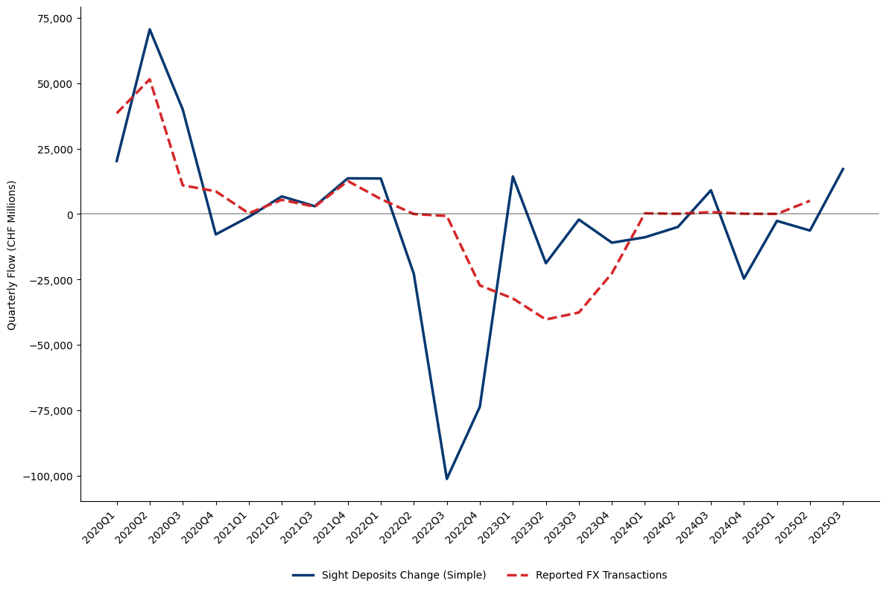
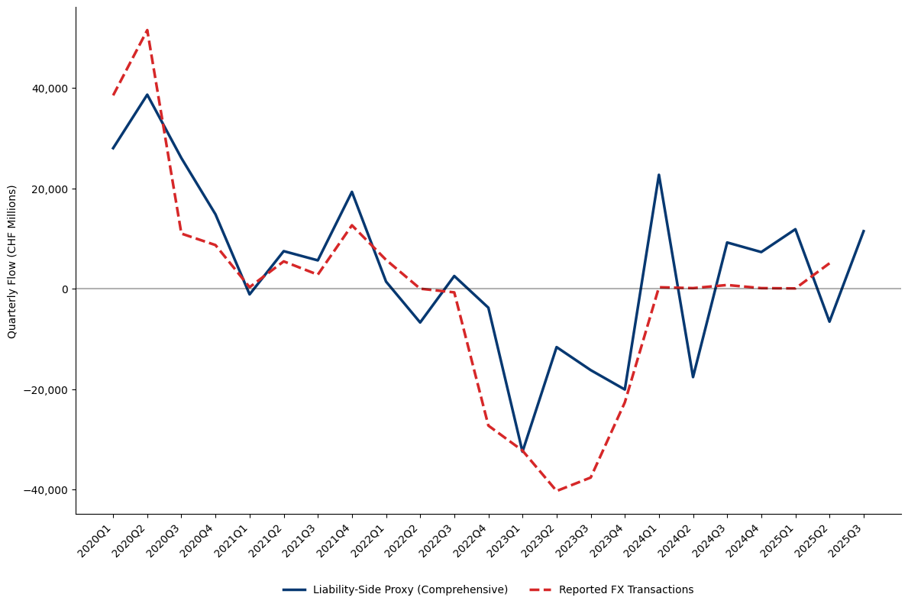
2.2 Liability-Side Approach – Results
Sight Deposits Only vs Reported FX Transactions
Full Liability-Side Proxy vs Reported FX Transactions
1-Month Delay
1-Month Delay
10
Source(s): SNB
SNB’s FX interventions

Slide 12
2.3 Asset-Side Approach 2.0 – Model
Model
Description
Monthly BS data gives timelier estimates than the official 3-month-delayed figures
IMFs provisional ’Official reserve assets excluding gold holdings’ data is released with only a 1 week delay
Reconstruct SNB’s portfolio using annual reports (asset classes, duration) and quarterly currency/region breakdowns
Residual monthly change = flow-driven intervention
Limitations
Limited access to asset-level return data makes precise portfolio replication difficult
IMF provisional reserve data is timely but not perfectly aligned with SNB accounting standards
Currency | USD | EUR | GBP | JPY | CAD | Other
Allocation (%) | 40 | 37 | 6 | 7 | 3 | 7
Asset Class | Gov. Bonds | Other Bonds | Equities
Allocation (%) | 64 | 11 | 25
11
Source(s): SNB, Bloomberg
SNB’s FX interventions

Slide 13
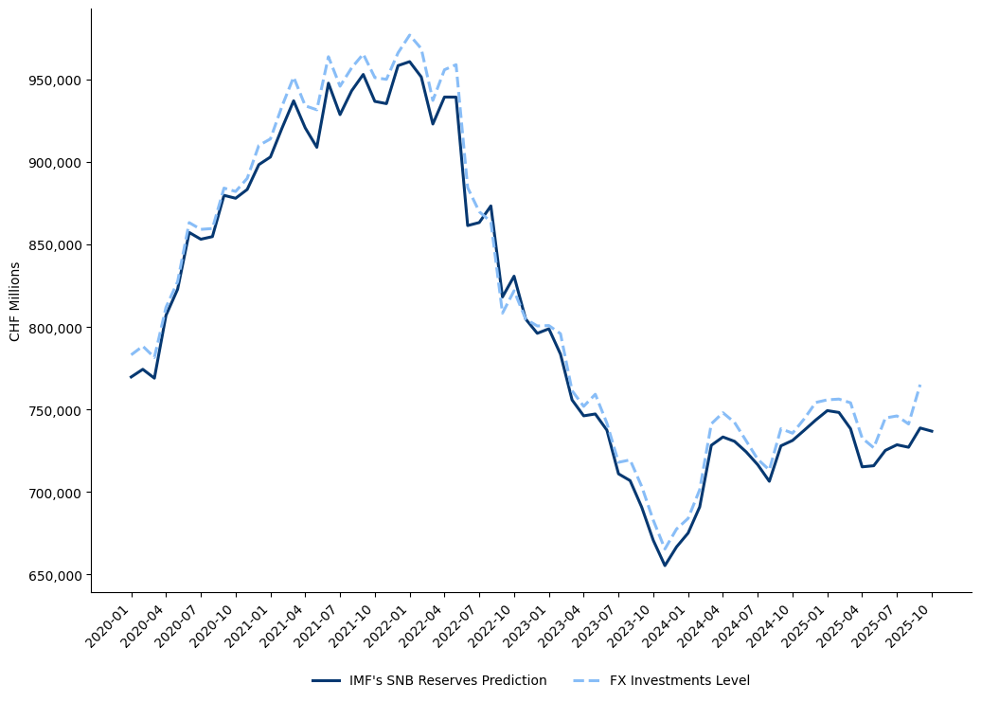
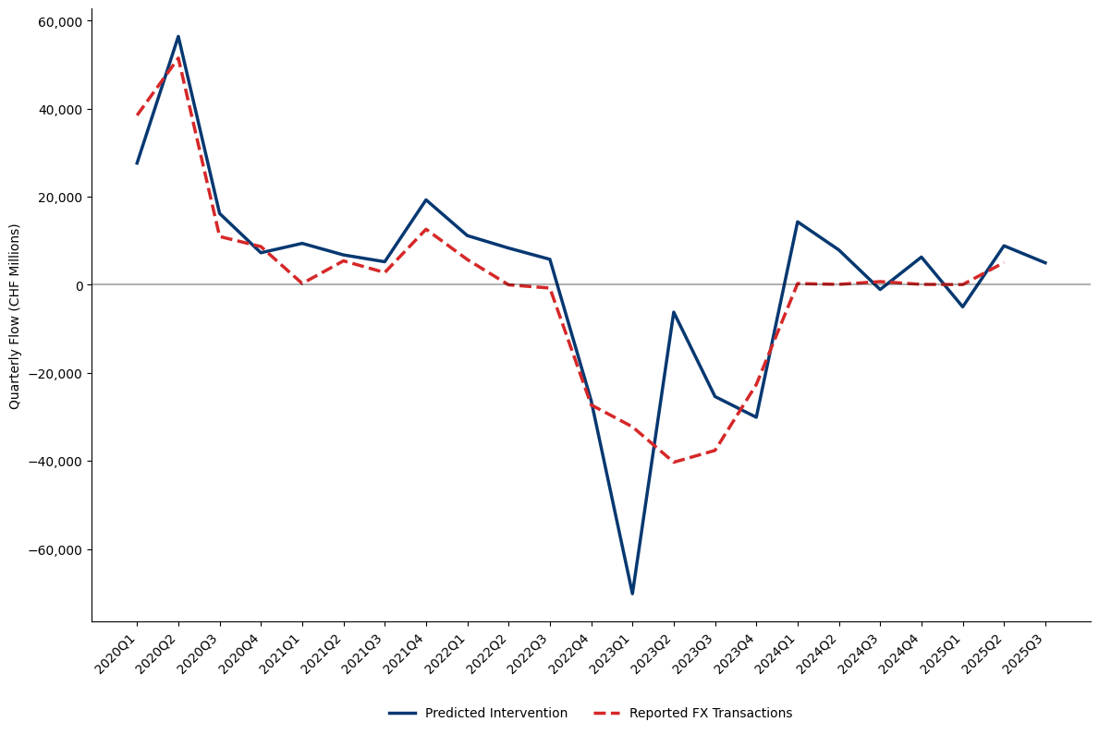
2.3 Asset-Side Approach 2.0 – Results
Monthly IMF Reserves vs FX Investment Level
Predicted Intervention vs Reported FX Transactions
IMF Provisional SNB FX Reserves
1-Week Delay
12
Source(s): SNB, Bloomberg
SNB’s FX interventions

Slide 14
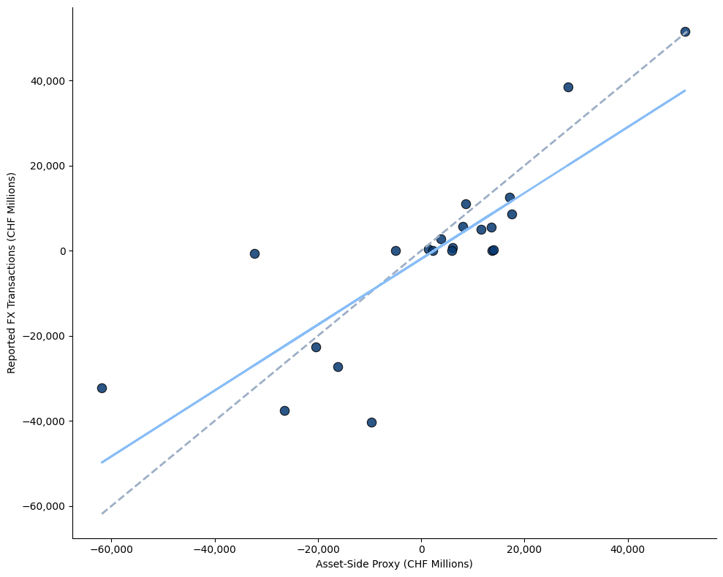
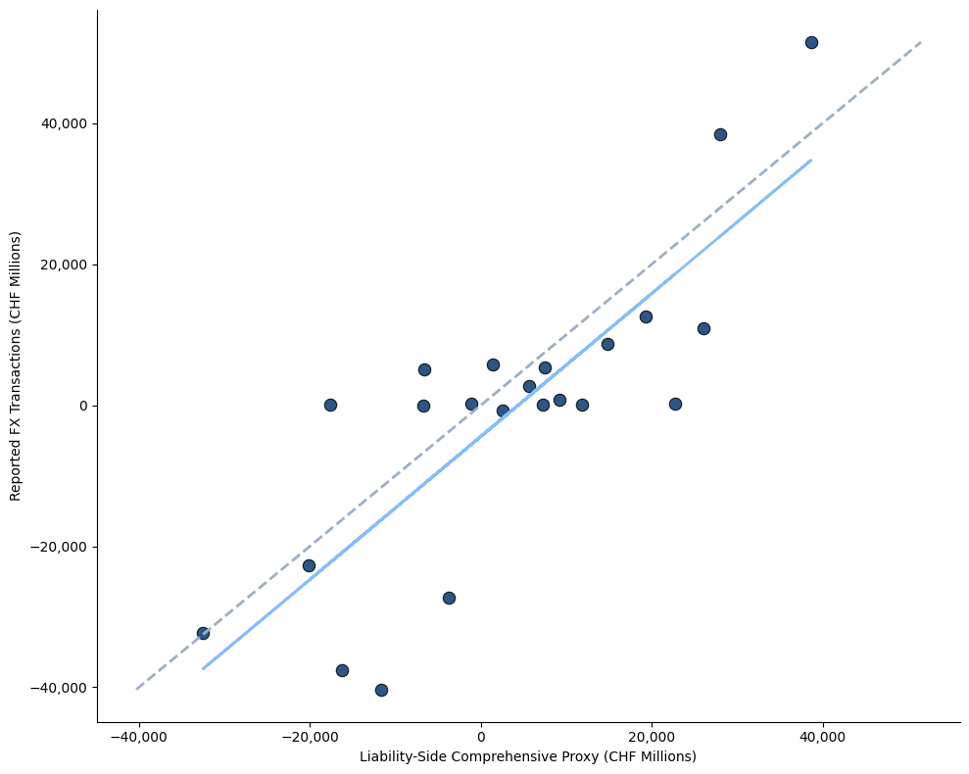
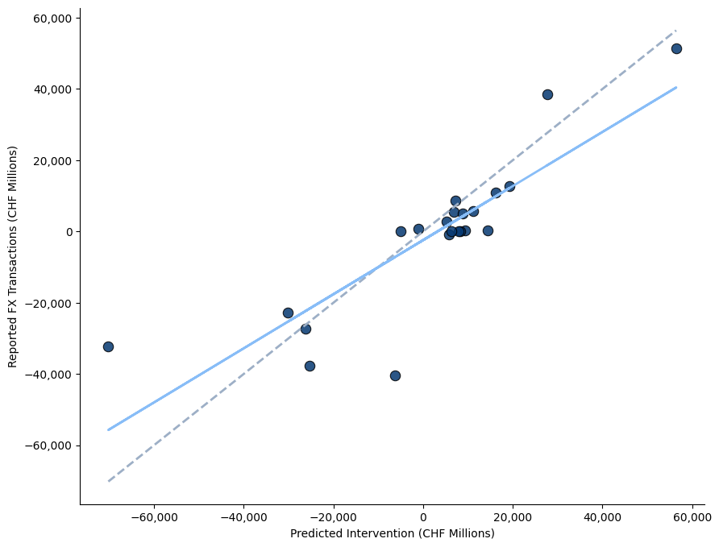
2.4 Comparison
Full Asset-Side Proxy vs Reported FX Transactions (Correlation)
Full Liability-Side Proxy vs Reported FX Transactions (Correlation)
Predicted Intervention vs Reported FX Transactions (Correlation)
Correlation: 0.825
Mean Absolute Error: 9,429.0 mCHF
Root Mean Square Error: 13236.4 mCHF
Correlation: 0.817
Mean Absolute Error: 10,336.9 mCHF
Root Mean Square Error: 13,012.4 mCHF
Correlation: 0.854
Mean Absolute Error: 8,806.1 mCHF
Root Mean Square Error: 12,785.3 mCHF
13
Source(s): SNB, Bloomberg
SNB’s FX interventions

Slide 15
SNB’s FX interventions
Thank you for your attention!
1

